Slide 1
Beyond Zoned Namespace, What Do Applications Want?
Chun Liu, Chief Architect, Futurewei Technologies

Slide 2












Landscape
Database/ DataStore
LevelDB
RocksDB
Distributed Storage
Native File Systems
Ext4
XFS
BtrFS
F2FS
ZFS
…

Slide 3
RocksDB builds on logs
Memtable
full
WAL is log
All SST files are logs
SST files vary in size
Write
Immutable
Memtable
Immutable
Memtable
Immutable
Memtable
Volatile
Persistent
Flush
Write-Ahead Log (WAL)
SST File
SST File
L0, 10s of MBs
SST (Static Sorted Table) File
SST
SST
SST
SST
SST
L1, 100s of MBs
Compaction
Manifest
SST
SST
SST
SST
SST
L2, GBs
….
Current
SST
SST
SST
SST
SST
Ln, 10s of GBs
[A..E]
[F..M]
[X..Z]
Key Range

Slide 4
Kafka also builds on logs
Broker_2
Kafka Cluster
Broker_1
My_Topic
Producer
Consumer
Broker_0
My_Topic
Broker
Topic_0
Broker
Broker
My_Topic
Producer
Consumer
Segments
Implemented via
Files: {log, index}
Topic_0
Topics
Partitions
My_Topic_0
Topic_1
Producer
Consumer
Implemented via
Directories
Topic_1
My_Topic_1
Topic_2
Leader
Topic_2
Partition is a log
Segments are logs
Partition append: create segment
Partition truncation: delete segment
HDFS is write-once + append + truncate as well
My_Topic_2
Topic_3
Follower
Topic_3
My_Topic_3
Replicated
Deletes
Reads
Appends

Slide 5
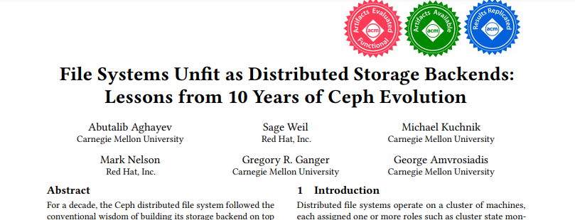
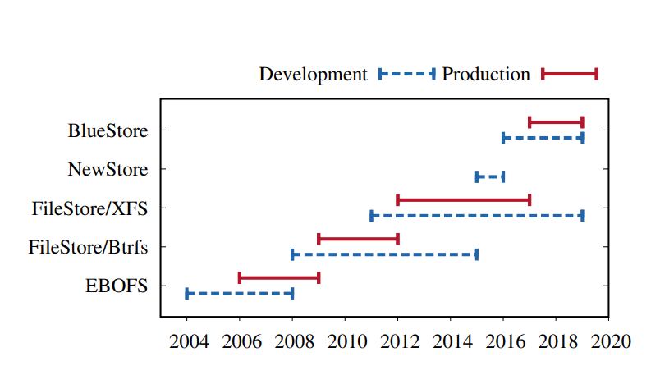
Ceph’s Lessons
RocksDB w/ Journaling FS
User Space WAL
Hook into FS internals

Slide 6
Ceph’s BlueStore
Client
OSD
BlueStore
Storage Node
Storage Node
Data
MetaData
RocksDB
OSD
OSD
OSD
BlueFS
Storage Device
Storage
Device
Bypassing file system, BlueFS provides a log interface.
BlueFS operates in user space, “runs on raw storage device” Stabilized in 2 years (not 10 years), due to simplicity and limited semantics.
Notes:
Add claimed benefits from BlueStore

Slide 7
Takeaways
“Databases”/Distributed Storages are using log-structured approach to manage data.
Log approach: append-only, immutable, delete-as-a-whole.
Logs vary in size, from several MBs to hundreds of GBs.
Most existing data processing frameworks are still using native file system, which is demonstrated to be “unfit”
Slow read-modify-write
Double writes
Slow to adopt new hardware like Zoned Namespace.

Slide 8
Zoned Namespace
Fixed Size Zones
Zone 0
Zone 1
Zone 2
…
Zone n-1
…
Write Pointer (WP), resettable
LBA 0
ZSLBA
ZSLBA+1
ZSLBA+2
ZSLBA+3
…
LBA+ZCAP-2
LBA+ZCAP-1
Sequential Write within a zone
Zone Mapping Config A
Zone State Machine
Zone 0
Zone 1
ZSIO
Zone n-1
ZSE
ZS RO
0
1
2
3
Flash Dies
Zone Mapping Config B
ZSF
ZSC
ZSEO
ZSO
Zone 0
Zone 1
…
Zone n-1
0
1
2
3
Flash Dies

Slide 9
Zoned Namespace (contd.)
Zone 2
Improved Performance
Bandwidth w/ reduced WAF
Tail latency w/ isolation and reduced GC
Reduce TCO
Less OP, DRAM, WAF and QLC adoption
SMR Drive: Extra Capacity.
Write Pointer (WP)
ZSLBA
ZSLBA+1
ZSLBA+2
ZSLBA+3
…
LBA+ZCAP-2
LBA+ZCAP-1
Append
Append
Append
ZSLBA+1
Can we do more?
Can we do better?
ZSLBA+2
ZSLBA+3
Append enables QD > 1 update via nameless writes
Time

Slide 10
Application Log in SSD
 | Application Log | ZNS
Append | Yes | Yes
Immutable until delete | Yes | Yes
Size | Variable Length | Fixed Size
Update Unit | May not aligned w/ sector | Sector Aligned
Name | Directory + Filename | ZSLBA (requires FS to map name -> LBA)
Map application logs natively onto ZNS? Two approaches:
Map logs into zones… (multiple logs in one zone, one log span multiple zones)
Internal fragmentation
Garbage collection due to shared zone
Still need naming to map name -> LBA
Extend the zone to support application logs with:
Variable Size
Byte-level Append
Naming
ZNS Named Log Extension or ZNS_{NLOG}
ZNS_{NLOG}

Slide 11
ZNS_{NLOG}
Extend the ‘Zone’ concept to be a
Named, Byte Append-able, Variable Size Linear Space.
1
Append₁
< sector
Append₂
2
Append₃
3
Name₁
WP
Append₄
4
Name₂
Zone id₁
Name₃
WP
…
Zone id₂
Sector
Zone id₃
1
2
3
4
Name_{inf}
…
Named
Zone id_{inf}
Minimal Program Unit actually
Variable Size
Byte Append-able
0
1
2
3
Flash Dies
Notes:
Application create name, device can reject a name.

Slide 12
RocksDB over ZNS_{NLOG}
Persistent
Write-Ahead Log (WAL)
SST File
SST File
L0
Naming the Zone eliminates filename->LBA mapping, making it robust.
SST (Static Sorted Table) File
Sector
SST
SST
SST
SST
SST
L1
1
2
3
4
Manifest
SST
SST
SST
SST
SST
L2
….
Name: L1_F_TO_M_010.SST
Name: L2_X_TO_Z_005.SST
Current
SST
SST
SST
SST
SST
Ln
No Read-Modify-Write
Improve WAL write
Key Range
Map different size SST files onto dedicated size-matching zones.
Less WA overall.
Zone Sm
x 65536
Zone Sm
Zone Sm
Zone Md
x 4096
Zone Md
Zone Md
Zone Lg
x 512
Zone Lg
Zone Lg
Notes:
Naming @ Device will make naming more robust.

Slide 13
ZNS_{NLOG} enables more NDP
Transparent compression of the logs.
Much larger size = better compression ratio.
Maintain original logical offset.
Offload RocksDB’s operations:
Compaction of SST files (merge-sort).
One zone is one SST file, no more native file system indirection.
Compaction can be offloaded to the SSD to leverage internal SSD bandwidth.
Search multiple SST files on the device.
Wildcard search, not supported by the current prefix or normal bloomfilter.
Offload Kafka’s matching operations.

Slide 14
ZNS_{NLOG} applicable to PM
PM is byte-addressable and memory allocator dictates the size of allocated memory.
Adding a naming service, ZNS_{NLOG} can be easily implemented on PM.
SST File
SST File
SST (Static Sorted Table) File
SST
SST
SST
SST
SST
SST
SST
SST
SST
SST
….
Hotspots
SST
SST
SST
SST
SST
Key Range
Name: L5_X_TO_Z_120.SST
Name: L5_D_TO_E_110.SST
PM: Zones
SSD: Zones
PM: Zones
SSD: Zones
PM: Zones
SSD: Zones
RocksDB w/ SST on tiered zones: PM Zones and SSD Zones

Slide 15
Conclusion
ZNS_{NLOG} can bridge the semantical gap between applications and SSD, which traditionally was blurred by file systems.
Named, Byte Append-able, Variable Size.
ZNS_{NLOG} enables less write amplification, more log write performance, and provides more flexible and robust naming service.
ZNS_{NLOG} lowers the technical barrier for near data processing.
ZNS_{NLOG} concept is applicable to Persistent Memory.

Slide 16

Thank you
Please visit www.snia.org/pmsummit for presentations
16

